Slide 1
Electrocardiogram (ECG)
Monitor using AD8232
Lab #1
By Socheath Sok

Slide 2
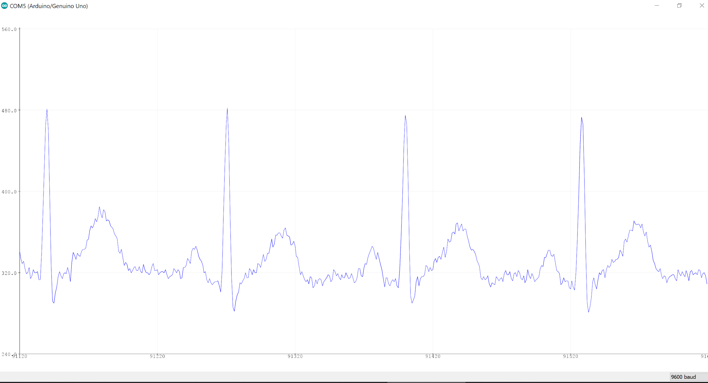

Slide 3
Overview
Background Information
Usage of ECG
Graph
AD8232
Electrodes Placement
Schematic

Slide 4
Introduction
A heartbeat is made up of an electrical signal followed by a contraction.
Start with the SA node sending out an electrical impulse.
Signal go from the Atria to the ventricles causing both chambers to contract.
In a healthy heart, the signal travels very quickly through the heart, allowing the chambers to contract in a smooth, orderly fashion.
SA Node
AV Node
[3]
Notes:
Sinoatrial Node and Atrioventricular

Slide 5
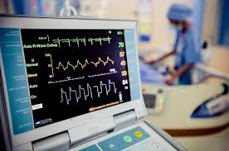
Electrocardiogram
Measure electrical signals produced by the heart
plot of these voltages over time
Give objective information about the structure and function the heart
ECG can detect:
Heart rate and rhythm
Heart attacks
Inadequate blood and oxygen supply
Structural abnormalities
[3]
Notes:
Heart contraction produce voltage which can be pick up electrodes.
The plot of these voltages over time is called an electrocardiogram
typically used to diagnose various forms of heart failure, or passively monitor patient stress

Slide 6
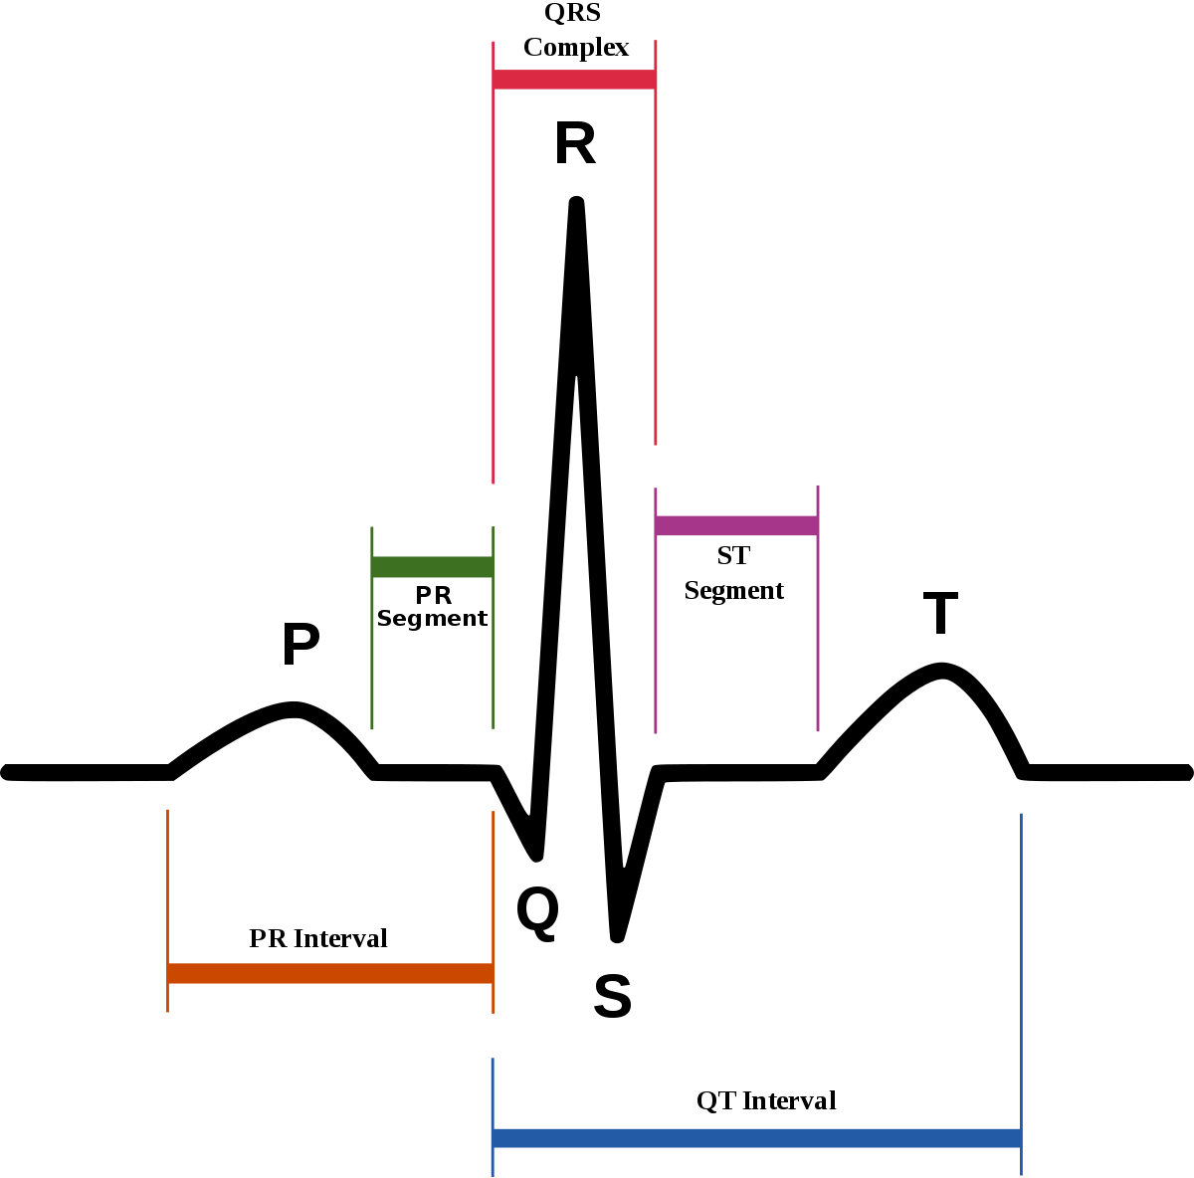
ECG Graph
P wave: right and left atrial depolarization
QRS Complex: a series of 3 deflections that associated with right and left ventricular depolarization.
T wave: ventricular repolarization
[3]
Notes:
Wave of atrial repolarization is invisible because of low amplitude.

Slide 7
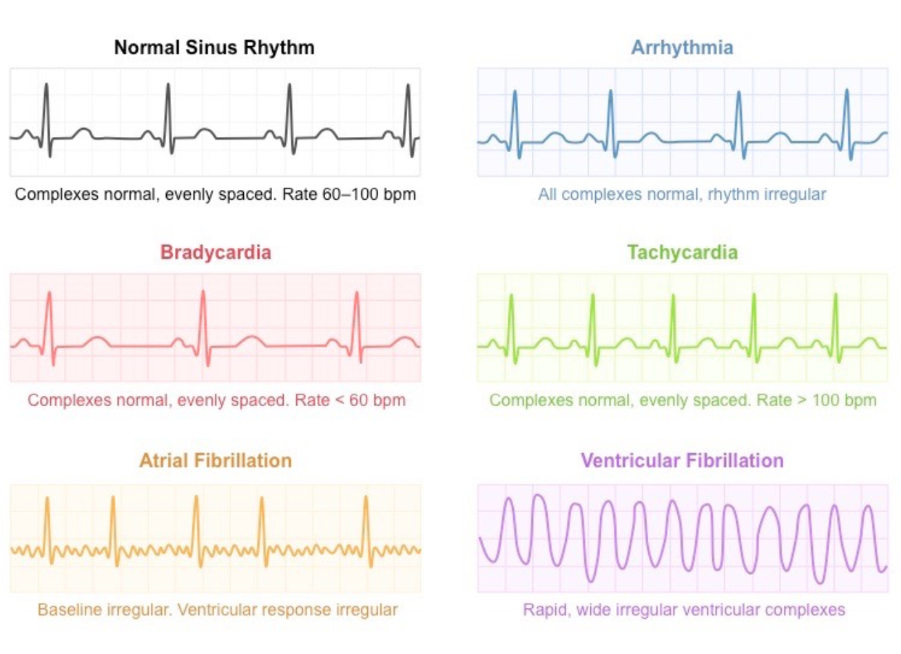
[3]

Slide 8
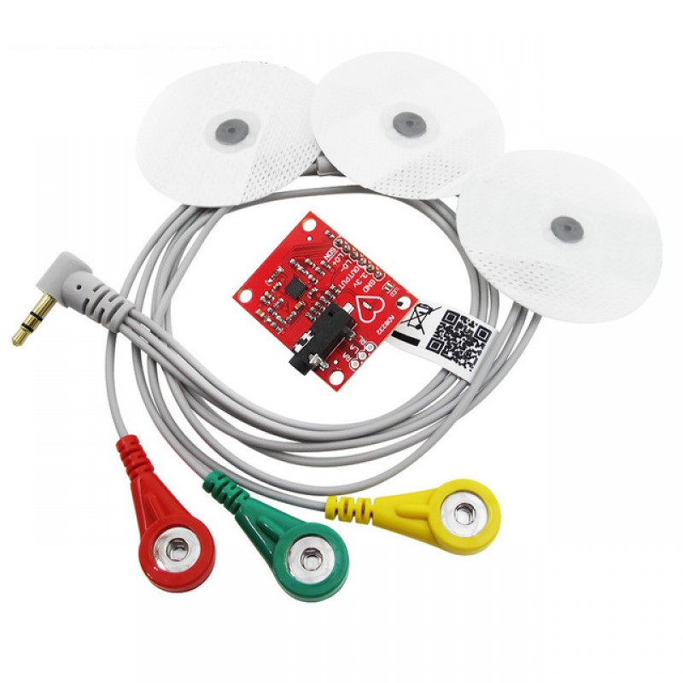
AD8232
Single-lead, heart rate monitor
CMRR: 80 dB
Gain: 100
Vin: +/- 300 mV
V supply: 2 to 3.5 V
Equipped with: LPF and HPF
[1]
Notes:
designed to extract, amplify, and filter small biopotential signals in the presence of noisy conditions

Slide 9
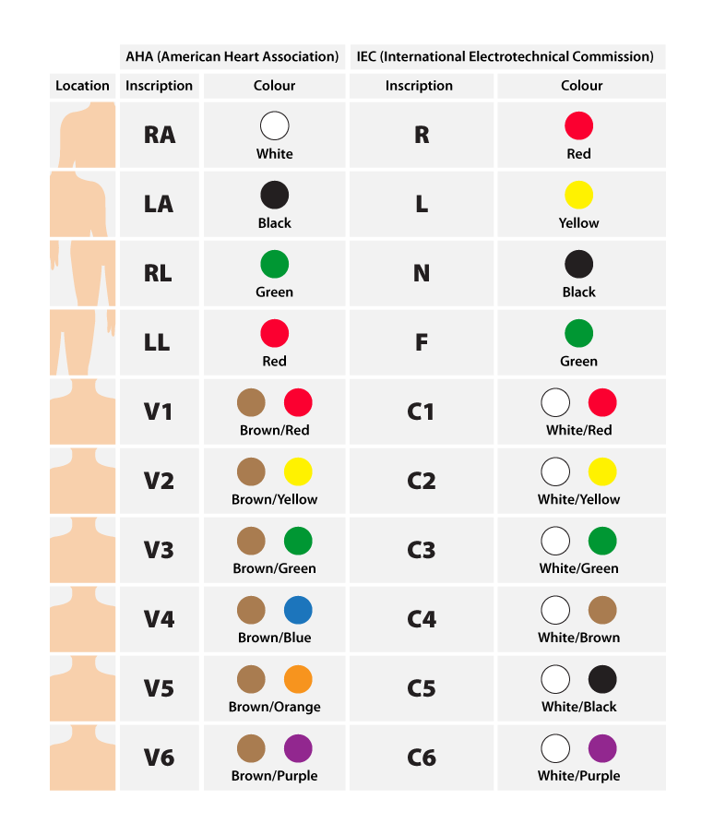
Electrodes Placement
[2]

Slide 10
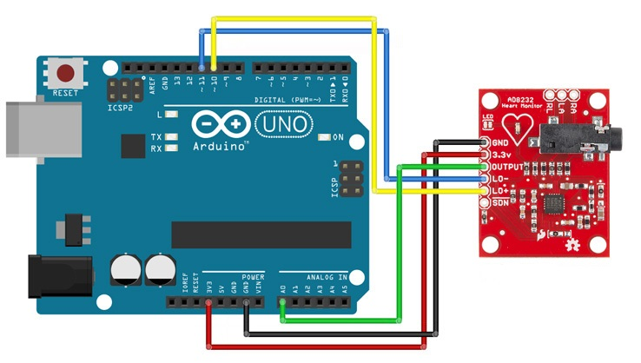
[2]

Slide 11
References
[1]“AD8232.” AD8232 Datasheet and Product Info | Analog Devices,
https://www.analog.com/en/products/ad8232.html#product-tools.
[2]Instructables. “Arduino Based ECG & Heartbeat Monitoring Healthcare
System.” Instructables, Instructables, 24 Sept. 2017, https://www.instructables.com/id/ECG-Monitoring-System-by-Using-Arduino-or-AD8232/.
[3]Pai, Rakesh K. “Sections.” Global, 7 Mar. 2012,
https://www.cardiosmart.org/healthwise/te71/47ab/c/te7147abc.

